Slide 1
Extending DAX with User-Defined Functions (UDFs)
Jake Duddy

Slide 2
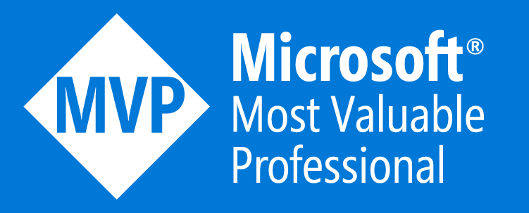





Jake Duddy
Data Platform Microsoft MVP
Fabric Community Super User
EvaluationContext Blog
Devon and Cornwall Power BI Group Co-organizer
evaluationcontext.github.io/
linkedin.com/in/jakeduddy/

Slide 3
What are DAX UDFs
User Defined Functions ≠ User Data Functions
Build your own DAX functions that you can call like any other DAX function
DRY (Don’t Repeat Yourself)
  Code that is repeated multiple times can be encapsulated in a single function
  Doesn’t improve performance
  Can make measures simpler/less verbose
  Can make bulk updates easier
They are built for semantic model authors

Slide 4
Parameters
Type
  ANYVAL: No restriction, any expression can be used
  SCALAR: Any scalar value, like an integer or a string; tables cannot be used
  TABLE: Any table expression, scalars are not allowed
  ANYREF: A reference to any table, column, measure, or calendar
Subtype
  VARIANT, INT64, DECIMAL, STRING …
  Casts parameters to specified type
Parameter-passing mode
  VAL (value): Resolved before being passed into function
  EXPR (expression): Resolved within function

Slide 5
Parameters are not measure
No implicit CALCULATE, no context transition

Slide 6
Comments
Specified with /// before the function definition
Shows up in IntelliSense

Slide 7
Model-dependent & Model-independent
Model Dependent
  Has expectations on semantic model schema
Model Independent
  Has NO expectations on semantic model schema

Slide 8
Naming Convention
https://docs.sqlbi.com/dax-style/dax-naming-conventions
  Suggestion, not required
JSDocs comments, why?
  https://evaluationcontext.github.io/posts/DAXUDF-AutoDocs/

Slide 9
DAXLib.org
DaxLib.FormatString
  Much easier to bulk update common format string
DaxLib.SVG
  SVG can be complex
    Need to know how SVGs are defined
    Need to know how to convert data to SVG definition
    Need to good enough at DAX for the conversion
    Need to make code performant

